Slide 1
e.g. [18F]FDG
[18F]VAT
Lingand
motion, change
Tracer Kinetic Modeling
And
1-Tissue Compartment Model (1TCM)
Aug 18, 2023
Zeyu Zhou
MIRA Group Meeting Review

Slide 2
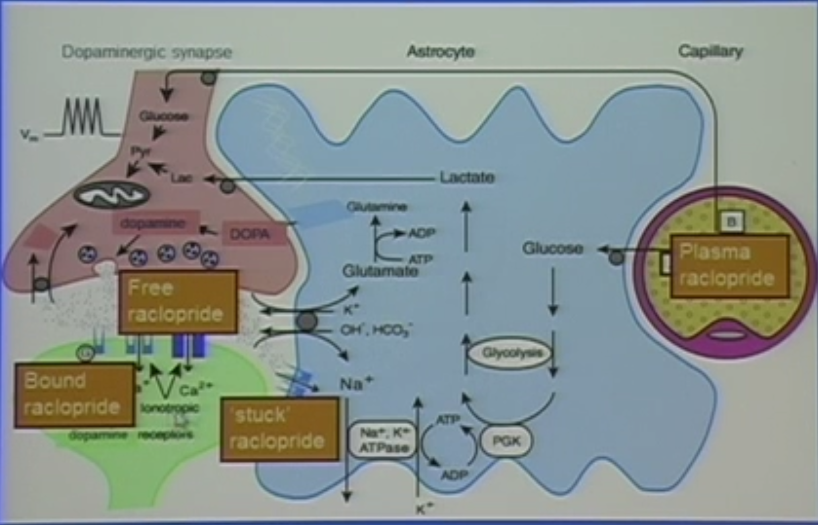
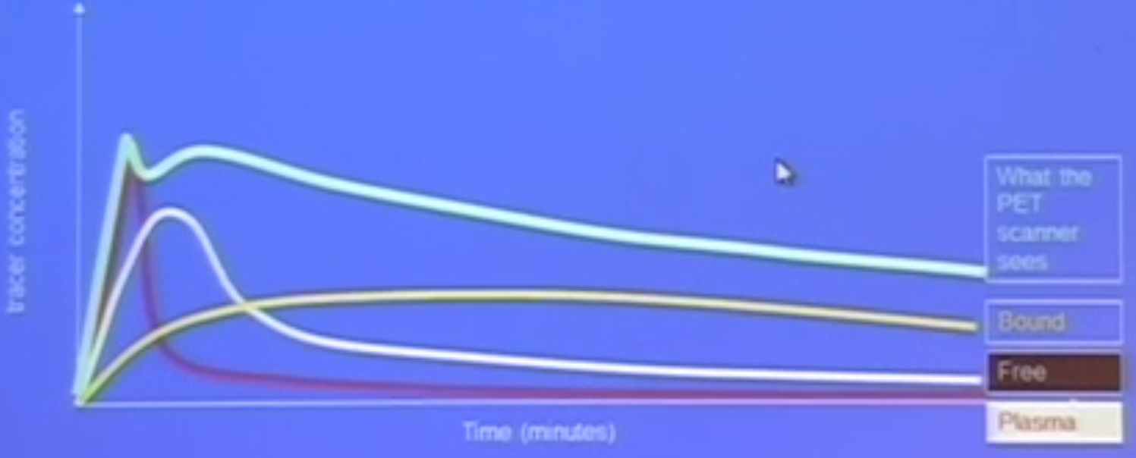
Motivation
A. Estimate the time course of states of tracer that we are interest in
Figure source: Evan Morris, ”Everything You Wanted to Know about what we Measure with PET – but were Afraid to Ask”, talk, June 2012
reflect
B. Often, model parameters
physiological and biochemical properties

Slide 3
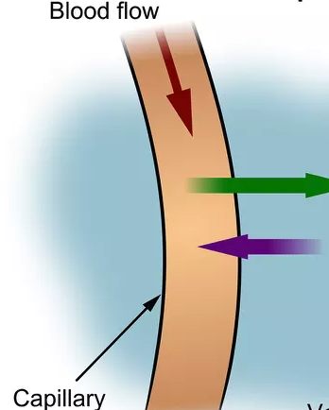
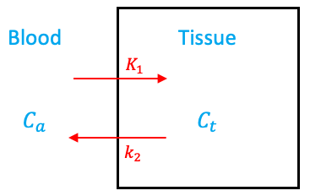
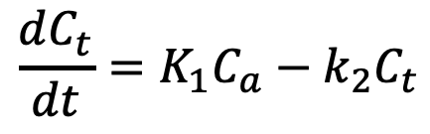
Compartment Model
Compartment: A possible state (physical location or chemical state) of the tracer
Tissue
$$\frac{dC_{t}}{dt}=K_{1}C_{a}−k_{2}C_{t}$$
rate constants

Slide 4
Compartment Model
Compartment: A possible state (physical location or chemical state) of the tracer
Tissue
$$\frac{dC_{t}}{dt}=K_{1}C_{a}−k_{2}C_{t}$$
rate constants
Assumptions:
Well-mixed
Tracer amount
First-order
Steady state
Steady state vs. equilibrium

Slide 5
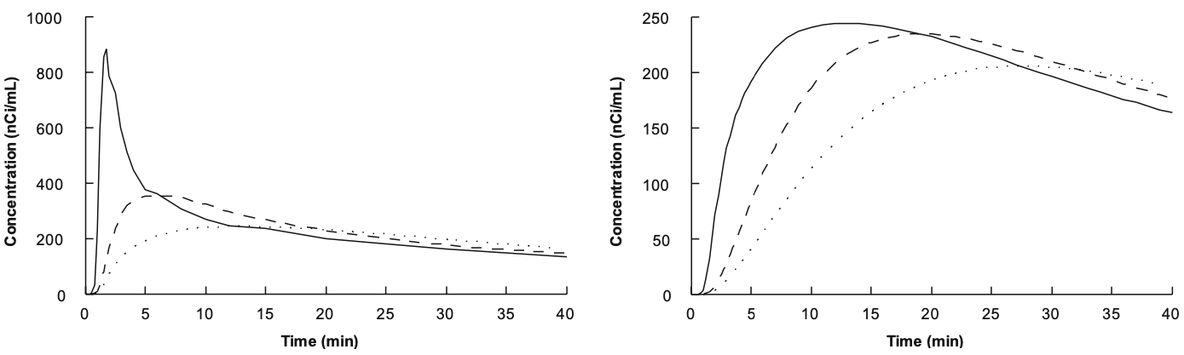
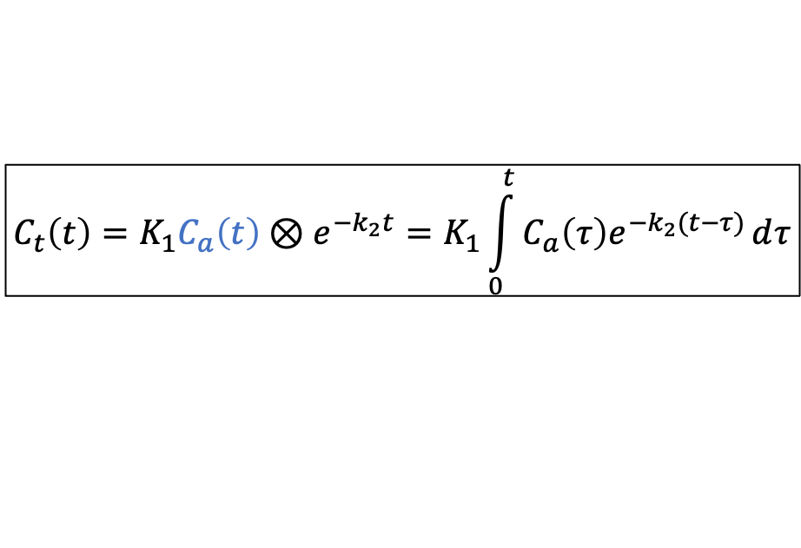



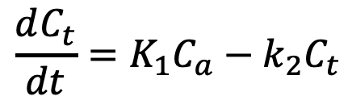


One Compartment Model
$$\frac{dC_{t}}{dt}=K_{1}C_{a}−k_{2}C_{t}$$
ml/min/g
ml/min/ml
$$C_{t}\left(0\right)=0$$
$$C_{a}$$
$$C_{t}$$
$$K_{1}$$
$$C_{t}\left(t\right)=K_{1}C_{a}\left(t\right)⊗e^{−k_{2}t}=K_{1}\int_{0}^{t}{C_{a}\left(τ\right)e^{−k_{2}(t−τ)}ⅆτ}$$
mCi/g
mCi/ml
Solution:
mCi/ml
$$k_{2}$$
min⁻¹
Arterial Input Function (AIF)
Figure source: Richard E. Carson, Tracer Kinetic Modeling in PET, In Positron emission tomography: basic sciences, 2005

Slide 6
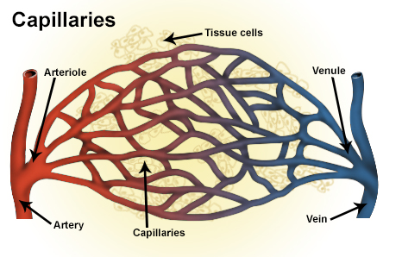
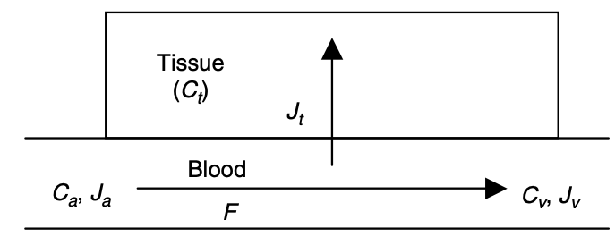
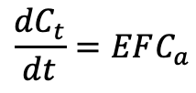


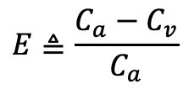
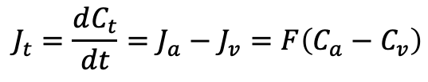

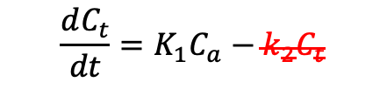
Interpretation of $K_{1}$
ml/min
ml/min/g of tissue
By Fick’s principle,
flow/perfusion
$$J_{t}=\frac{dC_{t}}{dt}=J_{a}−J_{v}=F\left(C_{a}−C_{v}\right)$$
Define
$$E≜\frac{C_{a}−C_{v}}{C_{a}}$$
Unidirectional first-pass extraction fraction
$$C_{t}=0$$
$$\frac{dC_{t}}{dt}=EFC_{a}$$
$$\frac{dC_{t}}{dt}=K_{1}C_{a}−k_{2}C_{t}$$
vs.
$$K_{1}=EF$$
$K_{1}$ = unidirectional first-pass extraction fraction x blood perfusion

Slide 7
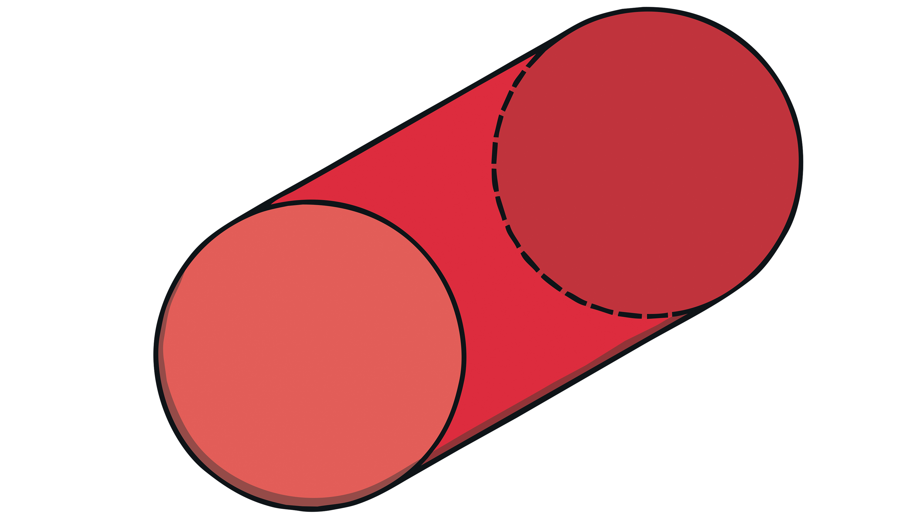


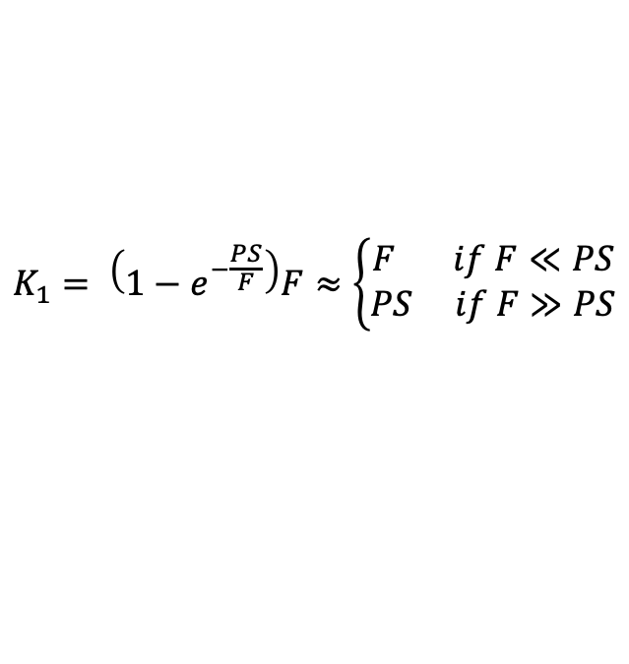
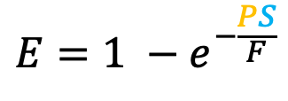
Interpretation of $K_{1}$
Renkin-Crone cylinder capillary model:
$$F$$
ml/min
ml/min/g of tissue
By Fick’s principle,
flow/perfusion
$$PS$$
$$J_{t}=\frac{dC_{t}}{dt}=J_{a}−J_{v}=F\left(C_{a}−C_{v}\right)$$
Capillary surface area per unit mass of tissue
permeability
Define
$$E≜\frac{C_{a}−C_{v}}{C_{a}}$$
$$E=1 −e^{−\frac{PS}{F}}$$
Unidirectional first-pass extraction fraction
$$C_{t}=0$$
$$K_{1}= \left(1−e^{−\frac{PS}{F}}\right)F≈\left\{\begin{aligned}F if F≪PS \\ PS if F≫PS\end{aligned}\right.$$
$$\frac{dC_{t}}{dt}=EFC_{a}$$
$$\frac{dC_{t}}{dt}=K_{1}C_{a}−k_{2}C_{t}$$
vs.
$$K_{1}=EF$$
$K_{1}$ = unidirectional first-pass extraction fraction x blood perfusion

Slide 8
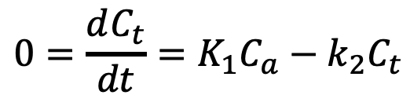

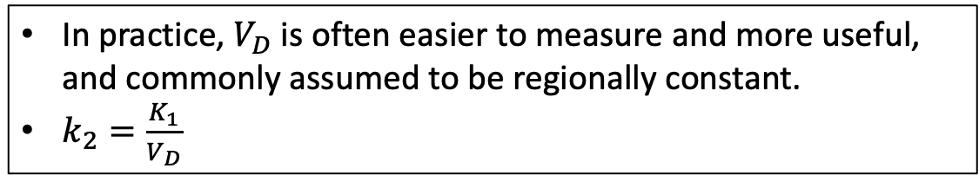

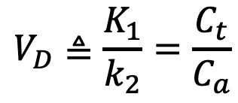
Interpretation of $k_{2}$
$$0=\frac{dC_{t}}{dt}=K_{1}C_{a}−k_{2}C_{t}$$
At equilibrium:
$$V_{D}≜\frac{K_{1}}{k_{2}}=\frac{C_{t}}{C_{a}}$$
Define
volume of distribution / partition coefficient
Interpretation of $V_{D}=2$:
same activity
2ml blood
1ml tissue
In practice, $V_{D}$ is often easier to measure and more useful, and commonly assumed to be regionally constant.
$k_{2}=\frac{K_{1}}{V_{D}}$

